Slide 1
LMRFC Reference Slide For Crest Tables
LMRFC Forecasts Issued Morning of February 25, 2022
Lower Mississippi
RIVER FORECAST CENTER
Talking Points
Over the next 7 days, little rainfall is forecast over the middle Mississippi and Ohio Valleys.
Minor to moderate flooding will continue on the smaller tributaries in Arkansas, Tennessee, north Alabama, and Mississippi over the next several days.
The lower Ohio River at Cairo, IL is forecast to crest at 45.5 ft on March 5th. Minor to moderate flooding is expected on the lower Ohio River over the next couple of weeks.
The crest levels on the lower Ohio River will be similar to levels reached in March of 2021.
As the crest moves downstream, minor flooding may be possible on the lower Mississippi River between New Madrid, MO and Osceola, AR. Cresting conditions are not expected to reach New Orleans, LA until mid March.
The 16 day future rainfall guidance shows the same crests on the lower Ohio and lower Mississippi Rivers. The guidance does shows minor flooding continuing a week longer on the lower Ohio River.

Slide 2
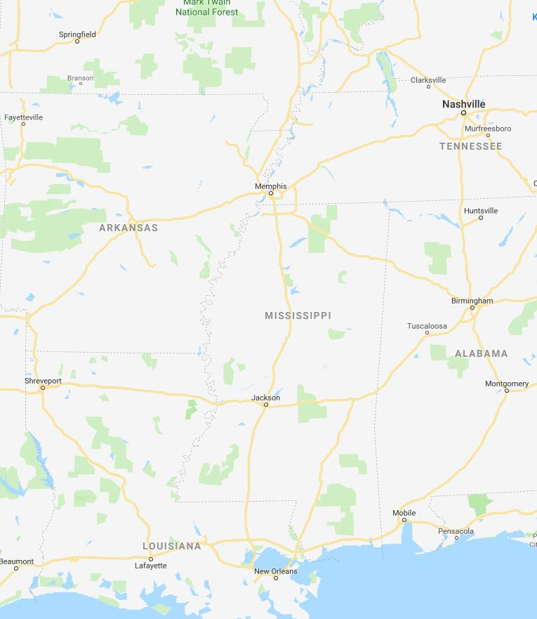
Ohio/Mississippi River Crest Watch
Created February 25 2022 @ 12:00 pm CDT
Lower Mississippi River Forecast Center weather.gov/lmrfc
NWSLMRFC
@NWSLMRFC
MS River at Caruthersville
OH River at Paducah
Current: 30.5’
2 Days
ACTION
Current: 40.6’ MINOR
Forecast:
Crest in MINOR at 34.0’ on March 6th
Forecast:
Crest in MODERATE at
43.5’ on March 4th
2 Days
0.5 Day
MS River at Memphis
OH River at Cairo
Current: 25.2’
Current: 42.2’
Crest in ACTION at 29.3’ on March 8th
MINOR
Forecast:
Forecast:
Crest in MINOR
at 45.5’ on March 5th
MS River at Ark City
5 Days
MS River at Greenville
Current: 27.0’
Current: 37.4’
Crest at 33.2’ on
March 11th
ACTION
Forecast
Forecast:
Crest in ACTION at 42.3’
on March 11th
2 Days
1 Day
MS River at Natchez
MS River at Vicksburg
Current: 38.3’
Current: 32.1’
Forecast:
Crest in ACTION at
46.5’ on March 14th
Forecast:
Crest in ACTION at 39.0’ on March 12th
2 Days
MS River at Baton Rouge
2 Days
MS River at New Orleans
Current: 22.8’
Current: Estimated 7.2’
Forecast:
Crest in ACTION at
31.8’ on March 16th
Forecast:
Crest at 11.7’ on
March 18th
Bonnet Carré Location
Morganza Location

